Slide 1
TEST AUTOMATION & DIGITAL QA SUMMIT
#TAS20
Sydney - Online - Virtual
May 28-29, 2020

Slide 2
Postman live demo & Postman object model
by Vincent Dirks

Slide 3
Postman object models -live demo
abstract
Live demo using Postman and show you can re-use code with a code library.
Dive into a new idea: "Postman Object Models".
A POM defines classes in a code library to persist data as Postman variables. The class objects can then be used throughout your scripts using standard object references eg. session.authToken
The POM classes are abstractions that hide the data persistence inside the class. You can create getters and setters for validation checks, and many other helper routines.

Slide 4
whoami
Vincent Dirks - full stack agile test analyst
I’ll give anything a go
Mobile
Web
API
DevOps
visual modelling
tools tools tools
widgets
scripts
automation x 4 years
not a developer
testing x 7 years
LeasePlan
Trade Me
Fiserv
test philosophy
Context Driven Testing
agile is to me
Autonomy
with Responsibility
through Trust

Slide 5
whoareyou
test analysts starting their journey into automation
This presentation is aimed at people who are beginning their journey of learning to program automation scripts to help their testing.
I am aiming this talk to people who are inexperienced with programming and realise we won’t let the developers have all the fun by themselves.

Slide 6
overview
live demo
Postman as you might be using it now
how to reuse code
using classes in your code
Postman Object Models

Slide 7
the API under test
let’s explore the API created for this presentation
host: http://localhost:5000
routes
/api/v1/info
/api/v1/rates/info
/api/v1/rates
/api/v1/person
/api/v1/person/login
/api/v1/person/accounts
/api/v1/person/account/{{accountId}}/transactions

Slide 8
Postman
as you might be using it now...
create GET requests for
http://localhost:5000/api/v1/info
http://localhost:5000/api/v1/rates/info
parameterise
{{hostURL}} = http://localhost:5000
create environment file
test
code snippets
response is 200
response body contains info array of strings
Chai assertion library
Notes:
pm.test("Status code is 200", function () {
pm.response.to.have.status(200);
});
pm.test("response contains info", function () {
const resp = pm.response.json(); //this can throw exceptions
pm.expect(resp.info).to.be.an('array');
resp.info.forEach(line => {pm.expect(line).to.be.a('string')});
}); //*/
/*
pm.globals.has(`codeLibrary`) && eval(pm.globals.get(`codeLibrary`)); //warning symbol is expected here
checkInfoResponse(); //*/

Slide 9
Postman
the sessionId ...
create POST requests for
http://localhost:5000/api/v1/person/login
save the sessionId
pm.globals.set('sessionId', resp.sessionId);
use the sessionId
GET http://localhost:5000/api/v1/person/accounts
header sessionid:{{sessionId}}
Notes:
pm.test("Status code is 200", function () {
pm.response.to.have.status(200);
});
pm.test("response contains info", function () {
const resp = pm.response.json(); //this can throw exceptions
pm.expect(resp.info).to.be.an('array');
resp.info.forEach(line => {pm.expect(line).to.be.a('string')});
}); //*/
/*
pm.globals.has(`codeLibrary`) && eval(pm.globals.get(`codeLibrary`)); //warning symbol is expected here
checkInfoResponse(); //*/

Slide 10
I keep writing the same test script…
how to reuse code
codeLibrary as a global variable
eval(codeLibrary) when needed
eval(pm.globals.get(`codeLibrary`));
I thought eval() was evil? only when you give users access to the executed string
Notes:
console.log("loading code library");

Slide 11

codeLibrary
how to create one in Postman
dummy request
to the most benign endpoint of your system
pre-request script - save `codeLibrary`
pm.globals.set(`codeLibrary`, `console.log("loading code library");` );
eval(codeLibrary) when you want to use it
eval(pm.globals.get(`codeLibrary`));
syntax highlighting

Slide 12
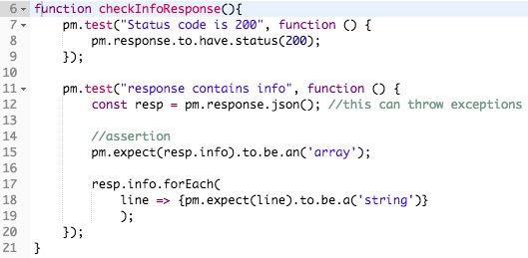
let’s code...
checkInfoResponse()
Notes:
function checkInfoResponse(){
pm.test("Status code is 200", function () {
pm.response.to.have.status(200);
});
pm.test("response contains info", function () {
const resp = pm.response.json(); //this can throw exceptions
pm.expect(resp.info).to.be.an('array');
resp.info.forEach(line => {pm.expect(line).to.be.a('string')});
});
pm.test("response contains list of requests", function () {
const resp = pm.response.json(); //this can throw exceptions
pm.expect(resp.requests).to.be.an('array');
resp.requests.forEach(line => {pm.expect(line).to.be.a('string')});
});
}

Slide 13

let’s test
/api/v1/info
run Code Library request to update the global variable
don’t forget to remove `syntax` highlighting
get & eval the codeLibrary
eval(pm.globals.get(`codeLibrary`));
run a function from the codeLibrary
Notes:
pm.globals.has(`codeLibrary`) && eval(pm.globals.get(`codeLibrary`)); //warning symbol is expected here
checkInfoResponse();

Slide 14
rinse and repeat
/api/v1/*/info
/api/v1/rates/info
/api/v1/rates
/api/v1/person
/api/v1/person/login (GET)
/api/v1/person/login (POST)
/api/v1/person/accounts
/api/v1/person/account/{{accountId}}/transactions

Slide 15
let’s reflect
simple API - had a look in Chrome
created requests in Postman & added checks
used {{variables}} & saved the {{sessionId}} after login
fetched the user’s accounts
created the codeLibrary as a global variable
implemented checkInfoResponse() function and used it for all /api/v1/*/info response validation

Slide 16
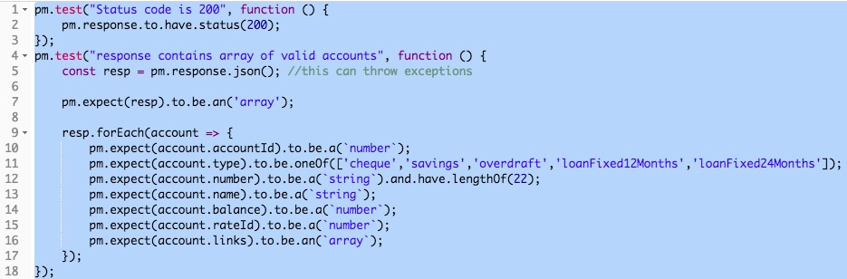
classes in the codeLibrary ?
I wonder if we could …?
let’s try encapsulate the account validation

Slide 17
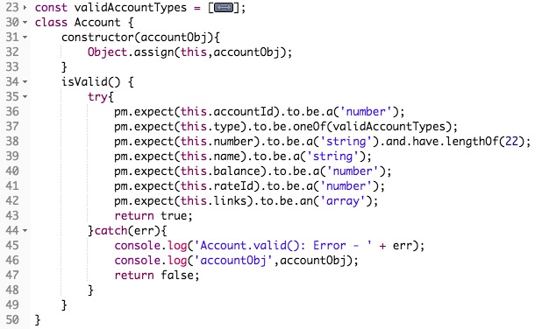
using classes in the codeLibrary
account class
Notes
valid account types array
constructor
using try..catch to manage exceptions
logging errors to console
could use schema check

Slide 18
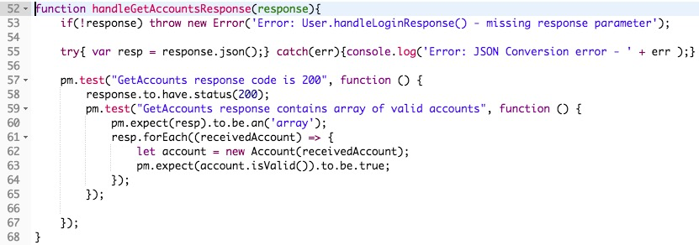
using classes in the codeLibrary
get account response handler
Notes
can use response input parameter
throw exception for incorrect usage
try..catch to manage JSON parsing exceptions
logging errors to console
account.isValid() checks itself ;-)

Slide 19
create the User class
design
properties
name
password
constructor with parameters
{ "name":"Grace Hopper", "password": "Password123" }
use getters and setters
internal properties are prefixed with ‘_’
set globals for login
{{name}} & {{password}}
response handlers for login and logout

Slide 20
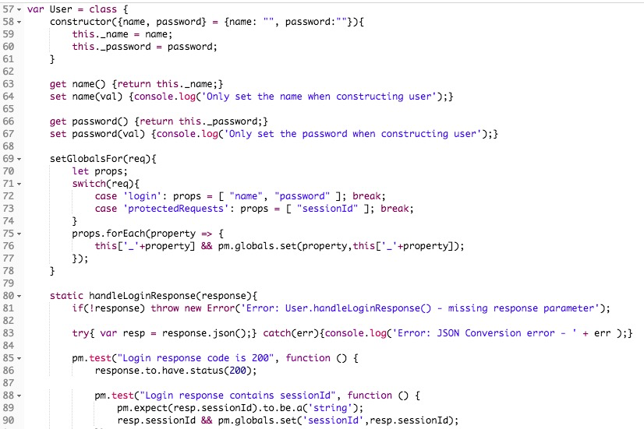
User class
implementation
Notes
slightly different class declaration
login handler is static

Slide 21
can we persist js objects ?
let’s try save js objects to the globals
only globals & environment variables persist between scripts and requests
javascript variable scope is limited to the script that declared it
wouldn’t be cool if we could create javascript objects in one script, and then be accessed in any other scripts… ?
maybe we can serialise js objects, and save them in the globals?

Slide 22
object persistence
design
each instance has to know its global variable name
save() serialises & saves instance to the globals
constructor() fetches & parses data from the globals
something needs to trigger the reconstruction of the object
usually whenever the codeLibrary is loaded (ie. eval’d)

Slide 23
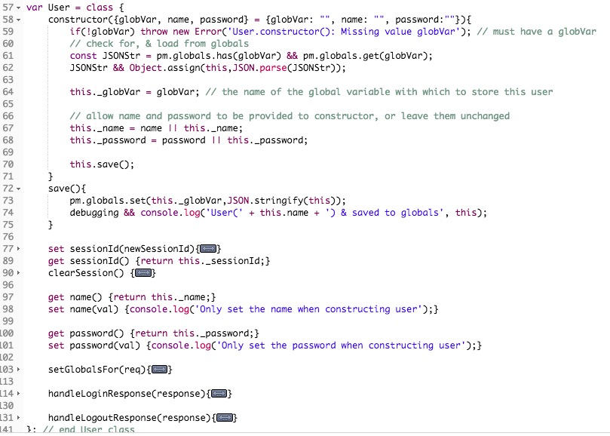
object persistence
implementation (User class)
Notes
fetch & parse JSON
save()
sessionId set/get/...

Slide 24
let’s use it...
the User class
login pre-request script
login test script
codeLibrary
automatically reloads the currentUser & sessionId if logged in

Slide 25
could we add the user’s accounts ?
after all they belong to the user
re-use the accounts class
add array of accounts to User class
get accounts response handler
checks status & accounts are all valid
adds valid accounts from response to user account list
save user

Slide 26
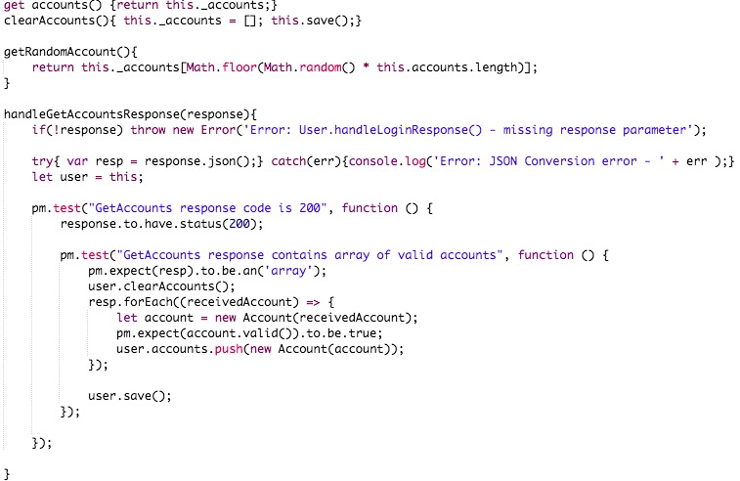
user accounts
implementation (User class)
Notes
check status
check accounts
push accounts

Slide 27
let’s reflect
Postman Object Model ...
we can use classes in the codeLibrary
encapsulated the account validation in Account class
created the User class with login/logout response handlers
persisted user objects by serialising into a global variable
used the persisted user in the login pre-req & test scripts
added user accounts to User class

Slide 28
thank you & questions ?
resources
Extra slides included after this one
GitHub
POM Postman Collection
simple test API
this google slide deck
feel free to share it
see me on
linkedin
www.dirksonline.net
testing@dirksonline.net
?

Slide 29
aside - javascript arrow functions
are ‘syntactically compact alternatives’
function nameOfFunction(inputParams){
do_some_stuff();
return x;
}
is the same as
inputParam => x …1 param, return x
() => x … no params, return x
(p1,p2,...) => x … multiple input params
param => {do_some_stuff(); return x;} … with statements

Slide 30


aside - javascript array methods
with arrow functions are way cool
At some point we will receive a response containing an array
don’t reference items by index
pm.expect(resp.info[2]).to.eql(someValue);)
use array methods find(), filter(), forEach(), map() etc.
pm.expect( resp.info.find(item => item.includes(...)) ).to.be.a(...);
MDN JavaScript Arrays
Notes:
add test
resp.info.forEach(line => {pm.expect(line).to.be.a('string')});

Slide 31
codeLibrary
"and" 'javascript' `strings`
these are all javascript strings
"double quotes"
"can have 'single quotes' inside it"
'single quotes'
'can have "double quotes" in it'
`backtick`
` can spread over multiple lines`
`can have ${expr} in the string`
Notes:
“ “
‘ ‘
` `

Slide 32
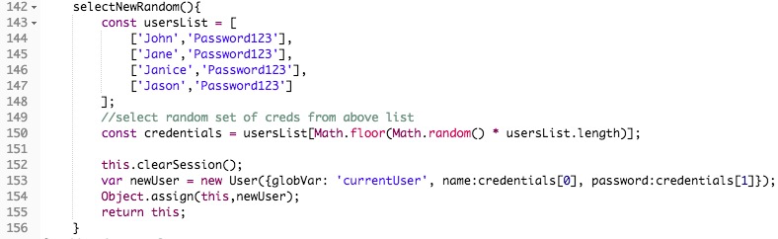
have some fun
select a random user
User class method
login pre-request

Slide 33
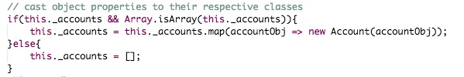
user accounts
User constructor changes
(re)construction from serialised global loses object type of properties
need to (re)cast each account to Account class

Slide 34
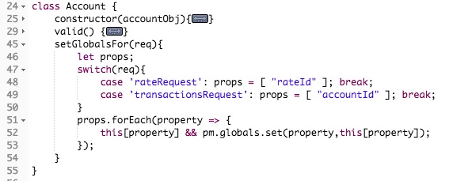
some more fun
get random account’s rate details and transactions
set globals for rate & transactions request in Accounts class
pre-request scripts
or

